Slide 1

COMPANY
OVERVIEW

Slide 2

About us
Flagstaffe is jointly owned and managed by Dan Brownsword and Kam Krupinski. Two FF&E professionals with a long history of achievement in project delivery.
Having worked together for over 20 years in senior management positions for two previous market leading businesses and between them having successfully delivered more than 100,000 rooms, including some of the UKs largest award-winning FF&E packages.
Flagstaffe have the knowledge and expertise to oversee delivery of your project to the highest possible standard.

Slide 3

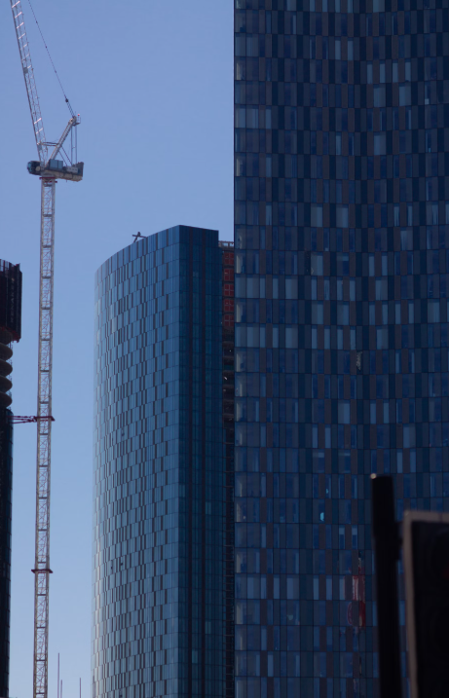




EXPERIENCE IS KEY
100k
Rooms delivered over a 20-year period
£7M
Turnover for FY26
93/100
Experian Score
Startup business of the year awarded 2024

Slide 4
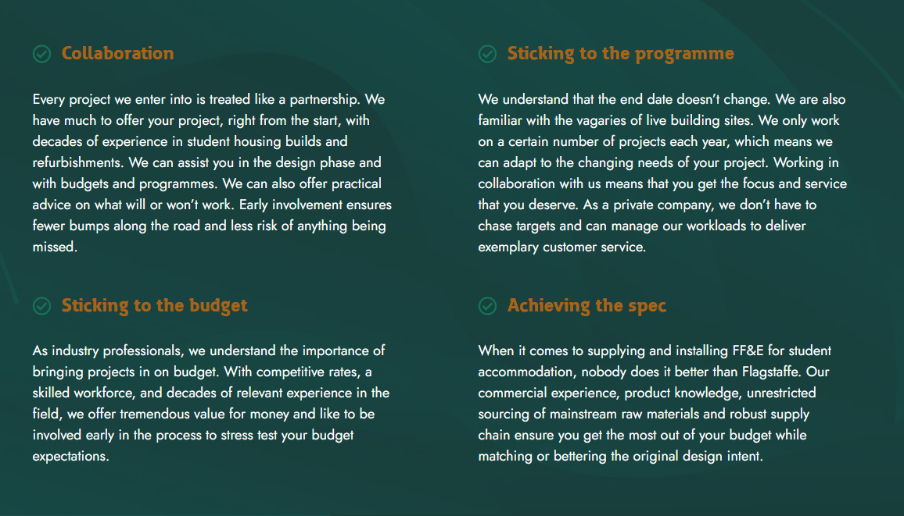

Slide 5
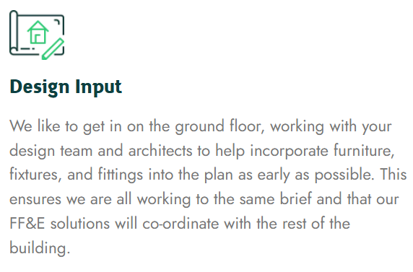
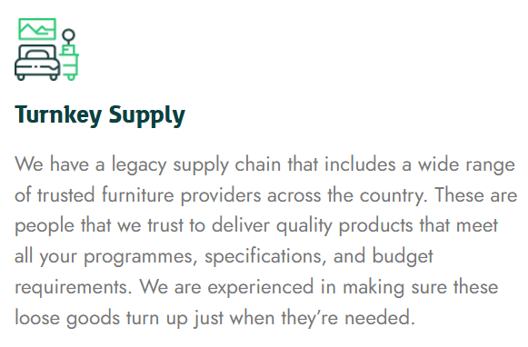
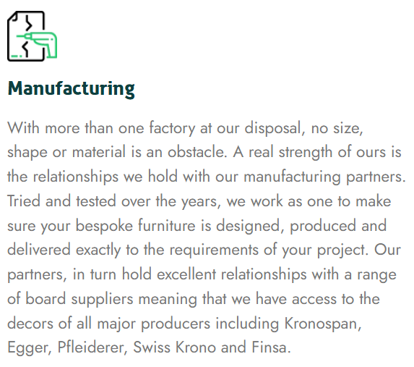

OUR SERVICES

Slide 6



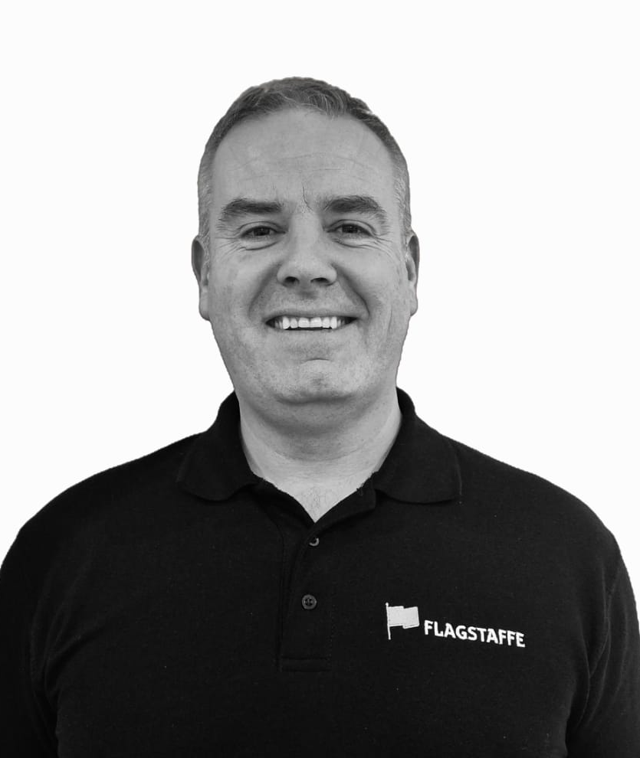
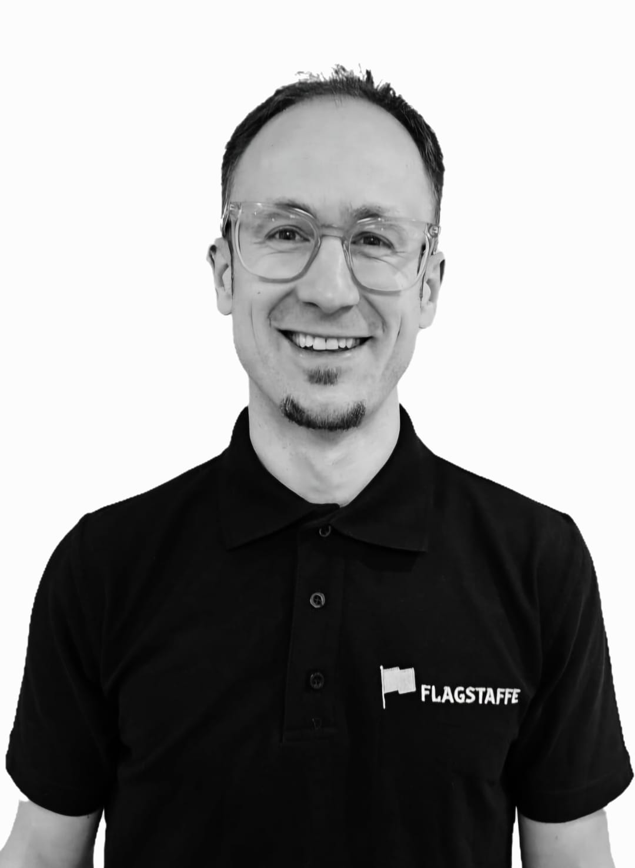
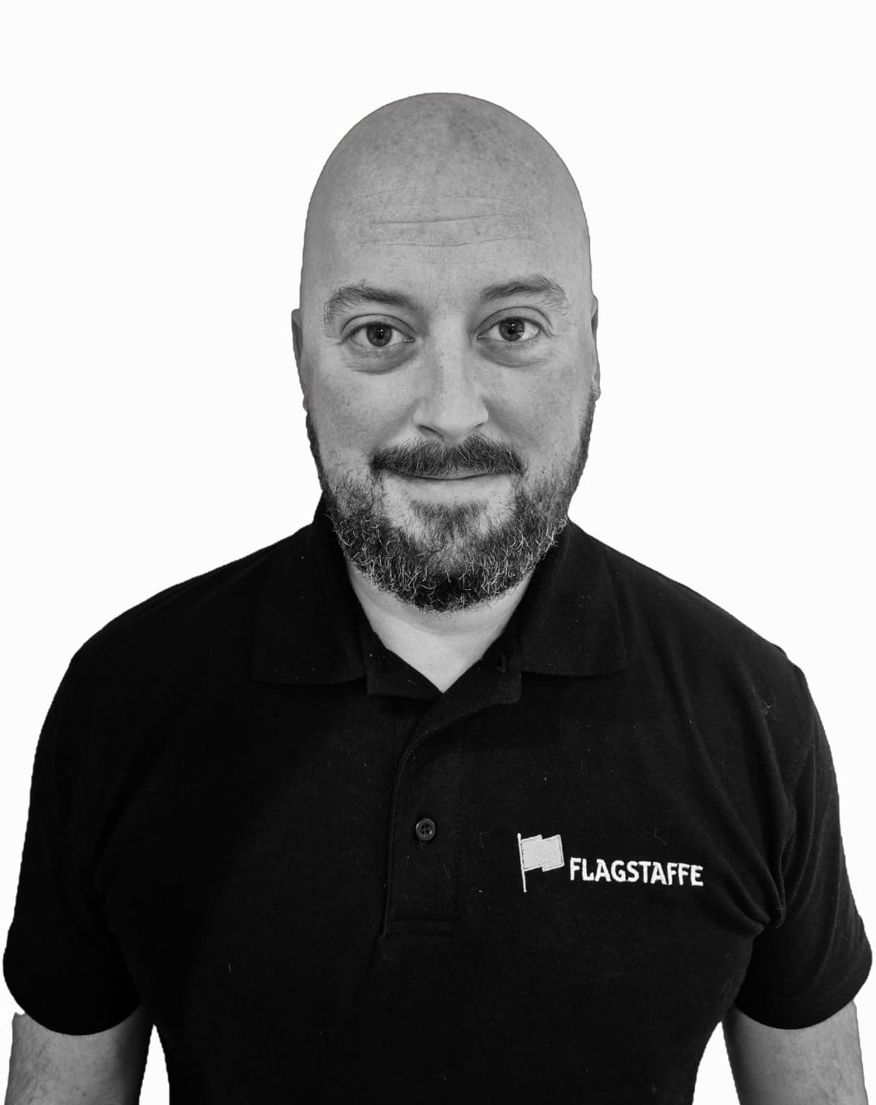
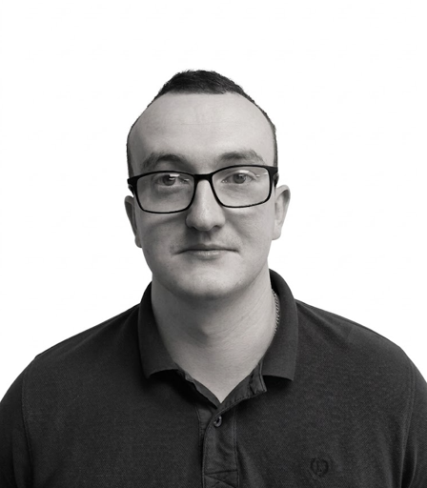
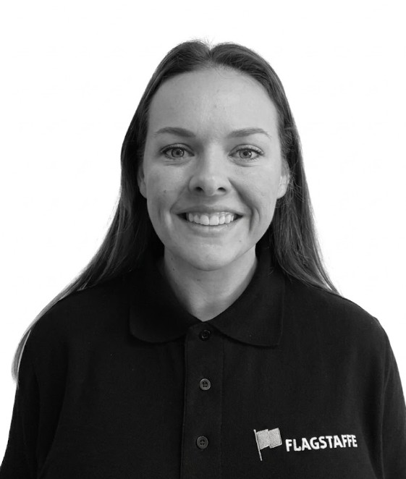
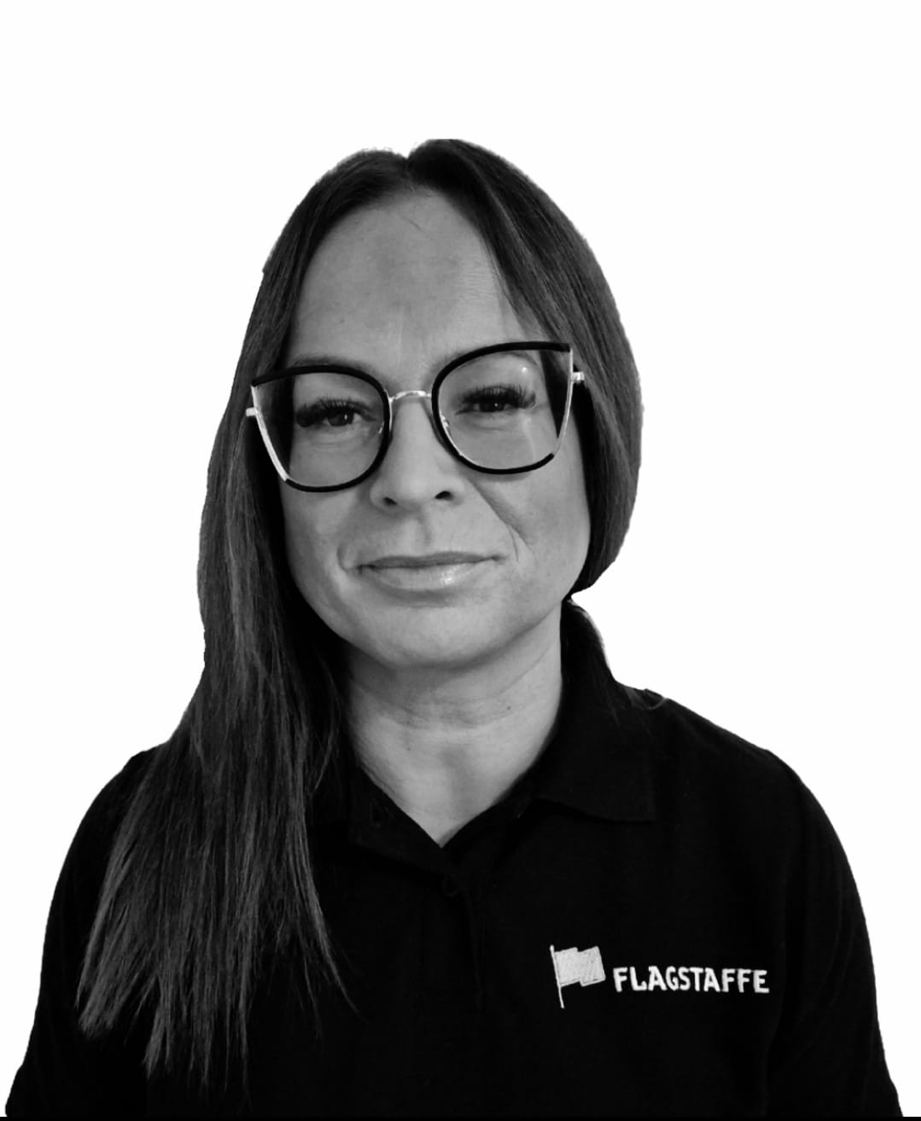
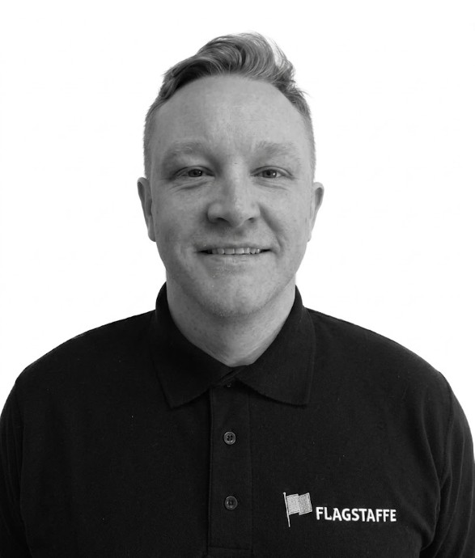
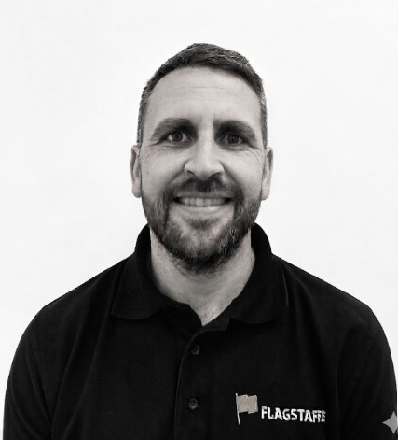
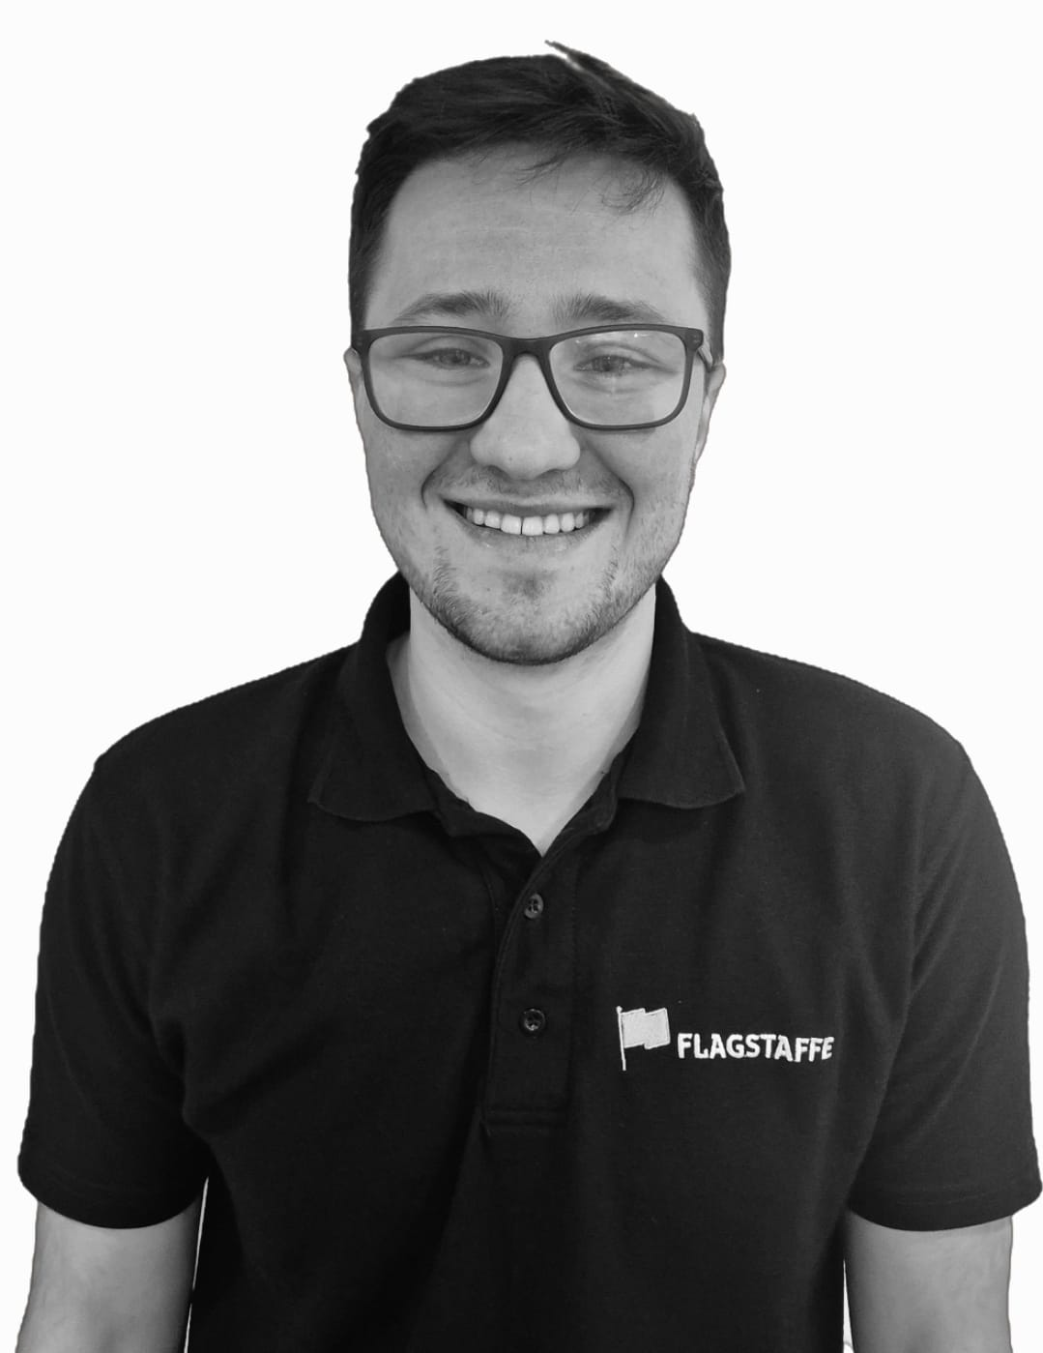
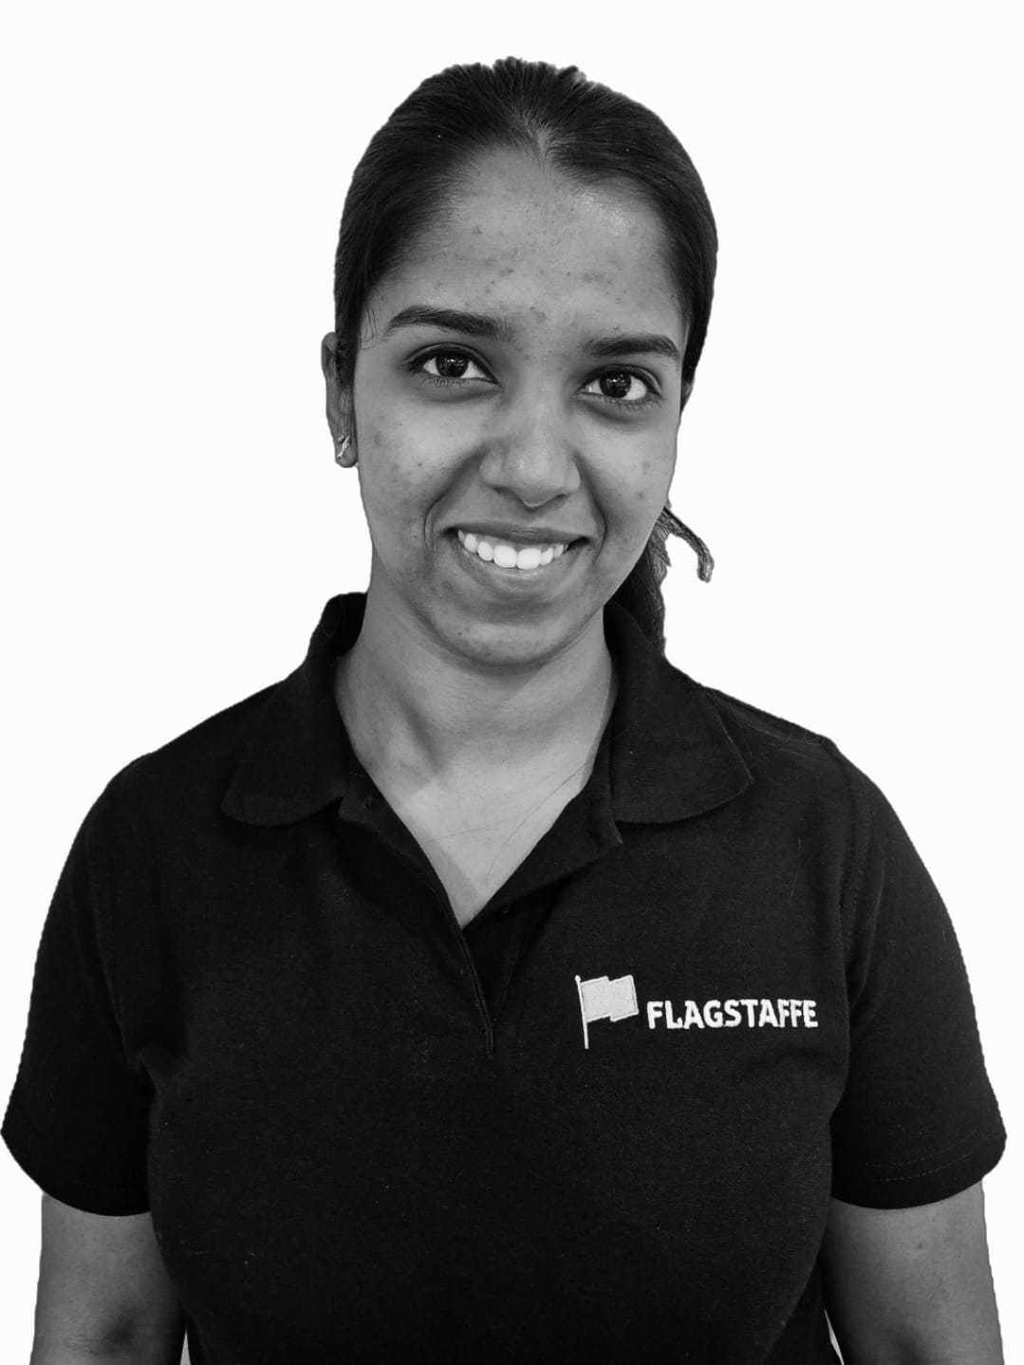
Meet the team
Dan brownsword
Kam krupinski
Jamie ward
Jimmy HoGG
Rachael marrow
Director
Director
Senior Estimator
Jr. Estimator
Head of Contract Coordination
Lidia karabanik
Steven Green
DanNy Collins
Joe barker
Arsha devasia
Accounts & Finance Manager
Contracts Manager
Pre Construction Manager
Coordinator
Coordinator

Slide 7

Contact us
​​
Find us at:
Granary Business Centre, Hollins Farm, Twemlow Ln, Holmes Chapel, CW4 8GE
enquiries@flagstaffe.com
​​
0​1260 460 003
www.flagstaffe.com

